Slide 1

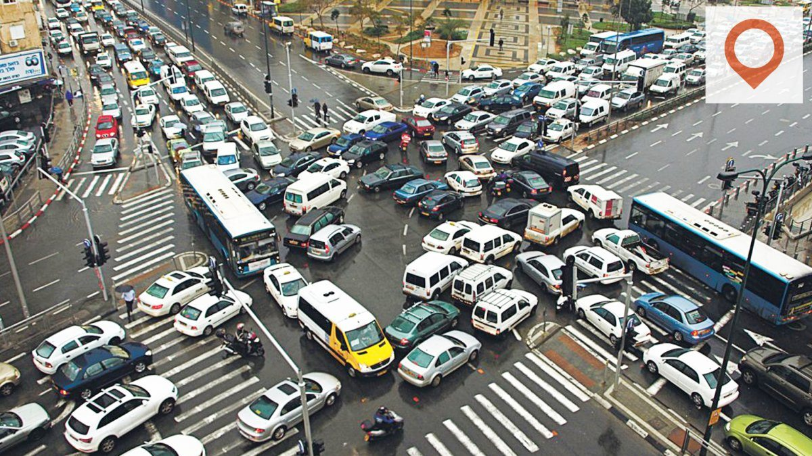

Optimal traffic routes prediction for shuttle service in Hyderabad

Slide 2


Project Leadership
Sharat Manikonda
Director at Innodatatics and Sponsor
linkedin.com/in/sharat-chandra
Ashutosh Hiskiel
Project Mentor
.linkedin.com/in/ashutosh-hiskiel-48ab651b7/

Slide 3

Team Members
Md Imran Iqbal
Team Member
linkedin.com/in/md-imran-iqbal-6a0a8921a/

Slide 4

Contents
Introduction
Project Goals
CRISP-ML(Q) Methodology
Technical Stacks
Project Architecture
Data Collection
Exploratory Data Analysis [EDA]
Data Visualization
Draw Graph
Adjacency Matrix
Centrality Measurement
Community Detection
Train-Test Split
Modularity Evaluation of Model
Model Building
Model Deployment
Screen shot of output
Video of output
Challenges
Future Scopes
Notes:
Change

Slide 5
Project Overview and Scope
This project is to be prepared for shuttle-system( Mini-Buses ) service provider in Hyderabad. with the aim to find optimum routes between different pick-up point like
Metro Station, MMTS, Bus Stop to IT Corridors of Hyderabad in working hours and
vice versa.
A Vendor can efficiently find the best routes for their shuttle system services at IT Corridors of Hyderabad, which helps to maximize revenue of Vendor and minimize reaching time of passengers as well.

Slide 6
Project Goals
To find best routes for shuttle system service provider through open-source data platforms (Secondary Data).
Maximize revenue of Vendor and Minimize reaching time of passengers as well.

Slide 7
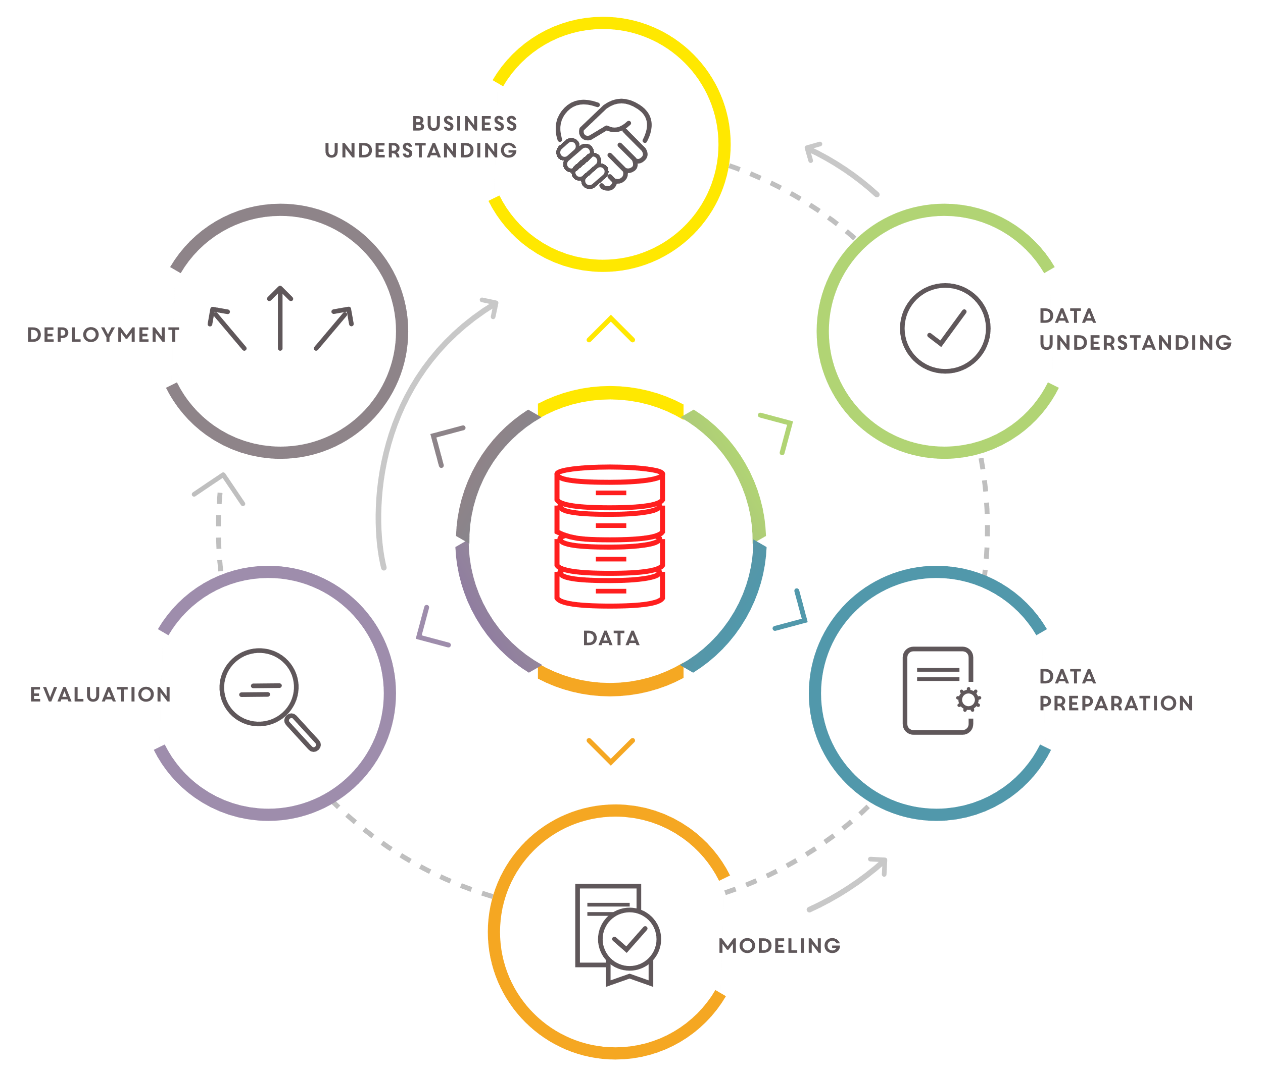
CRISP-ML(Q) Methodology

Slide 8










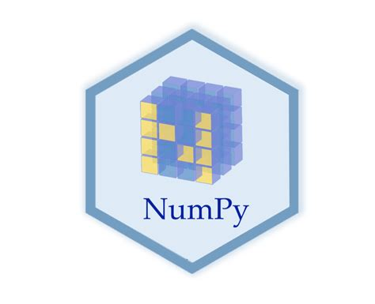


Technical Stacks
Notes:
Pycharm add Tableau

Slide 9







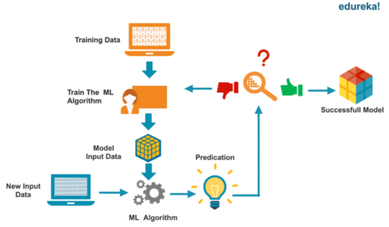
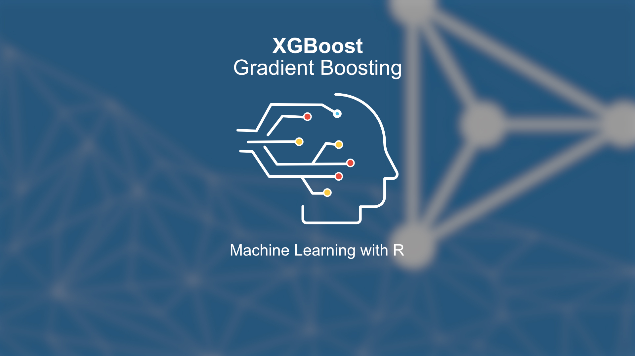
Project Architecture
Data Understanding and Data Pre-processing
Feature Engineering
Model Deployment
Model Building

Slide 10

Data Collection
Data Collection is defined as the procedure of collecting, measuring and analyzing accurate insights for research using standard validation techniques.
Data collection :
Primary Data Sources : Data collected at source (web scrapping from www.outscraper.com)
Secondary Data Sources : Data collected at source (web scrapping from www.google.com/maps & www.openstreetmap.org)

Slide 11

Data Information
In this model the data is analyzed considering the below features for the model building.
 | Data Dictionary
Sr.no | Name of the features | Description | Data Type
1. | Date | date of the day | Nominal
2. | Time | required time for prediction of optimal route | Nominal
3. | Source | pik-up / drop point of passenger | Discrete
4. | query_origin | pik-up / drop lat-long of passenger | Nominal / Discrete
5. | road | pik-up / drop point of passenger | Discrete

Slide 12
Data Information
In this model the data is analyzed considering the below features for the model building.
 | Data Dictionary
Sr.no | Name of the features | Description | Data Type
6. | Destination | pik-up / drop point of passenger | Discrete
7. | query_destination | pik-up / drop point of passenger | Discrete
8. | distance(meters) | distance from source to destinantion | Continuous
9. | avg_time(minutes) | average time taken from source to destinantion | Continuous
10. | speed_km_hr | average vechile speed from source to destinantion | Continuous

Slide 13

System Requirements
System Requirements
Memory: 4GB RAM
CPU: Intel Core i3 11th Gen
OS: Windows 11
Prepare Environment
Install python version 3.10.8
Install Anaconda software to launch IDE platform like Jupyter
Creating a new Environment
Install Pandas for preprocessing of data
Install NumPy for mathematical calculations
Install Seaborn & Matplotlib for Visualisation
Install sweetviz and dtale library for doing Auto - EDA
Install Networkx for operation on Network Analytics
Install Streamlit for web-frame work
Use Streamlit-Cloud, Heroku, AWS for Model - Deployment

Slide 14
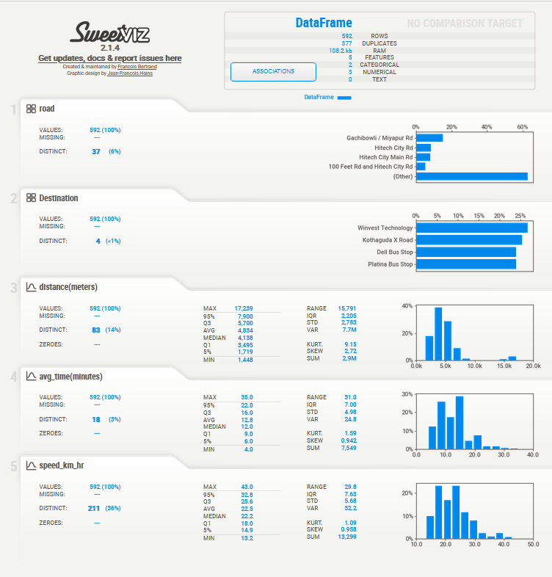
Auto - Exploratory Data Analysis [Auto - EDA]
Notes:
EDA is used for seeing what the data can tell us before the modeling task.
Change

Slide 15
EDA Description
Install sweetviz for Auto - EDA
remove outliers from numerical columns to make data normal
not carry those columns which is nominal in nature
After EDA the response sheet is ready for evaluation and further work.

Slide 16
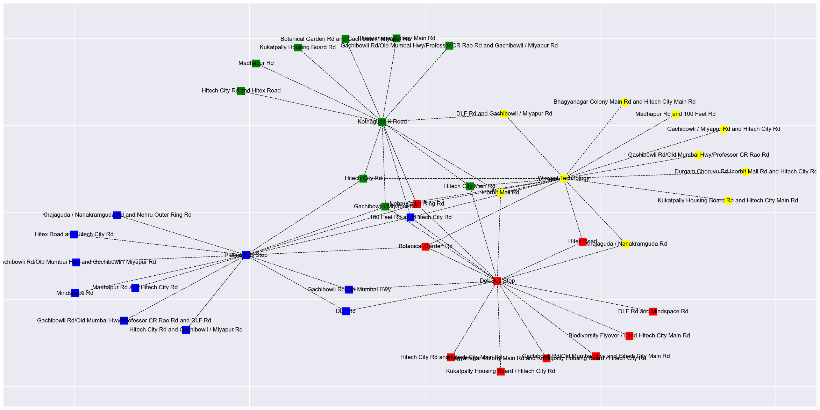
Data Visualization / Draw Graph
Notes:
Keep observations

Slide 17
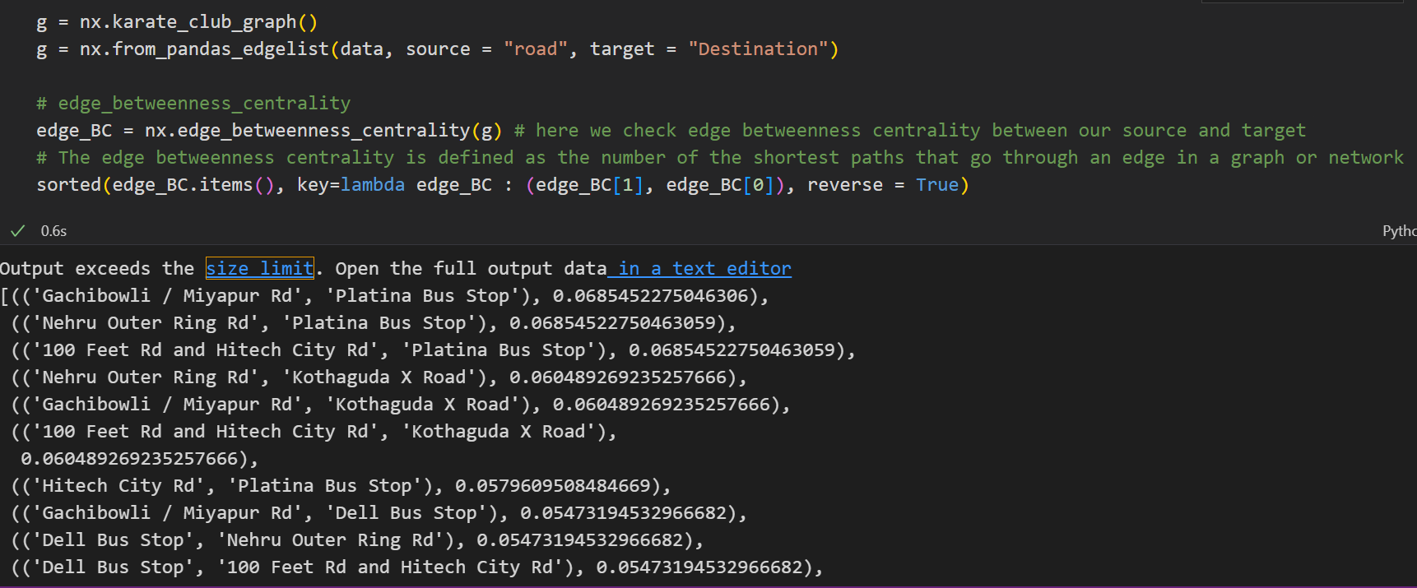
Calculate Centrality: edge_betweenness_centrality
Notes:
Add graphical

Slide 18
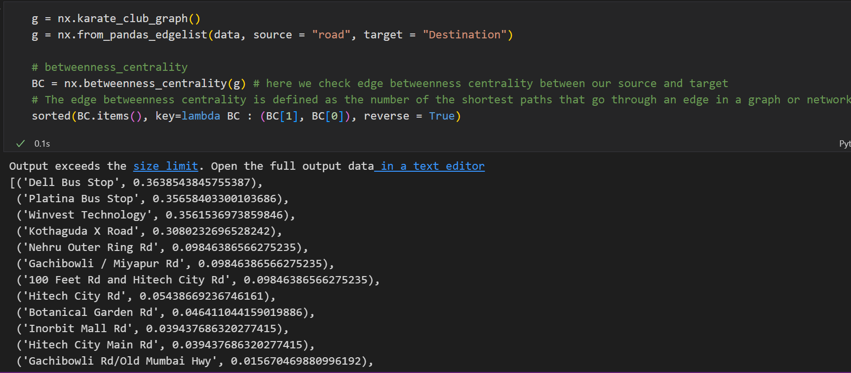
Calculate Centrality: betweenness_ centrality
Notes:
Piee

Slide 19
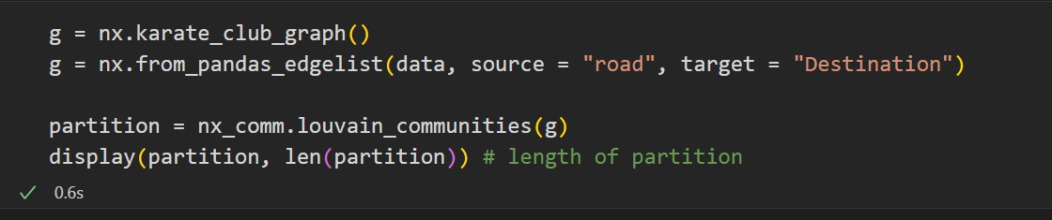
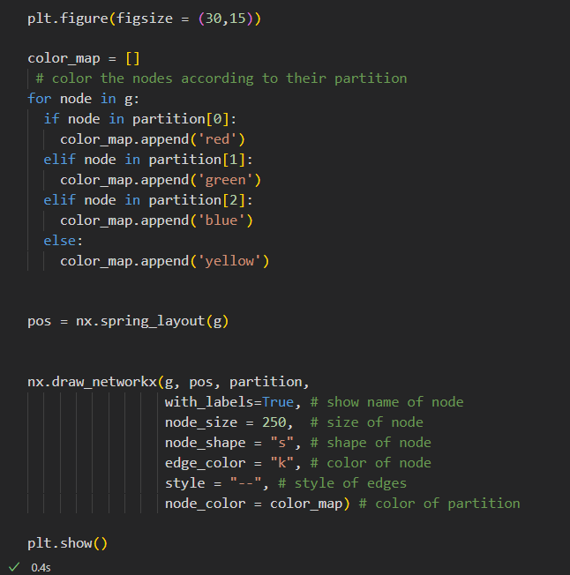
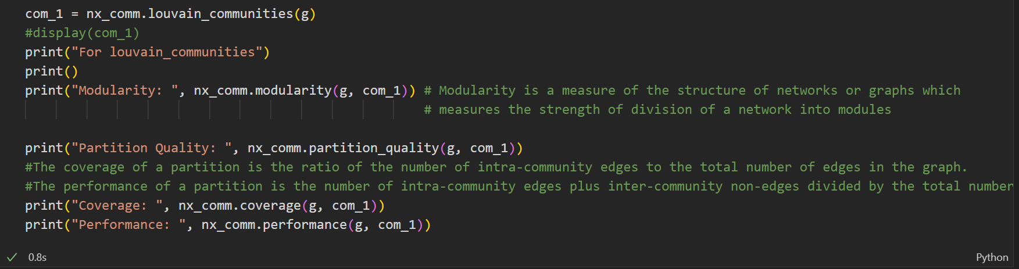
Model Building
Notes:
classification is the task of predicting a discrete class label. Regression is the task of predicting a continuous quantity.
What is classification techniques in machine learning?
The Classification algorithm is a Supervised Learning technique that is used to identify the category of new observations on the basis of training data. In Classification, a program learns from the given dataset or observations and then classifies new observation into several classes or groups.
What is regression techniques in machine learning?
Regression is a technique for investigating the relationship between independent variables or features and a dependent variable or outcome. It's used as a method for predictive modeling in machine learning, in which an algorithm is used to predict continuous outcomes.

Slide 20
Model Accuracy Comparison
Community - detection Model | Modularity Score | Partition Quality - Score
louvain_communities | 0.3767595518529159 | 0.6271186440677966, 0.7865853658536586
greedy_modularity_communities | 0.37647227808101125 | 0.6271186440677966, 0.7865853658536586
naive_greedy_modularity_communities | 0.37632864119505893 | 0.6271186440677966, 0.7865853658536586

Slide 21
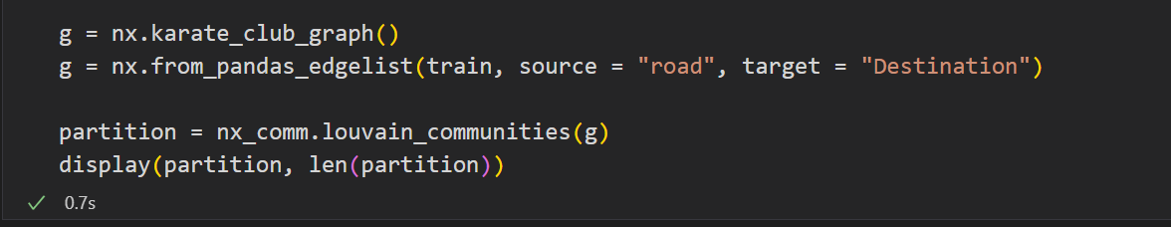
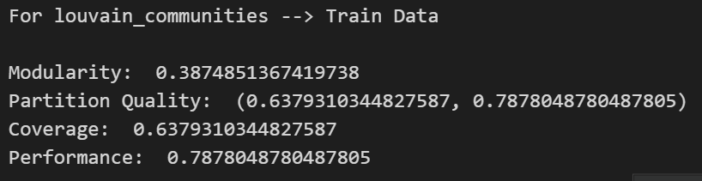
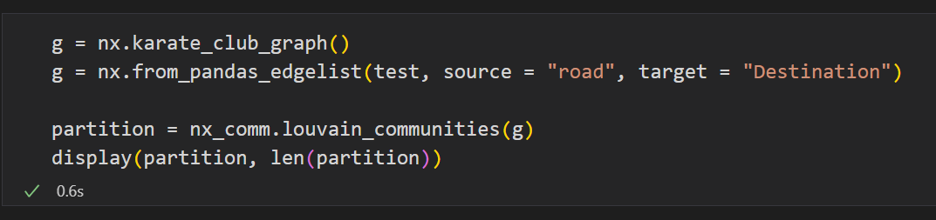
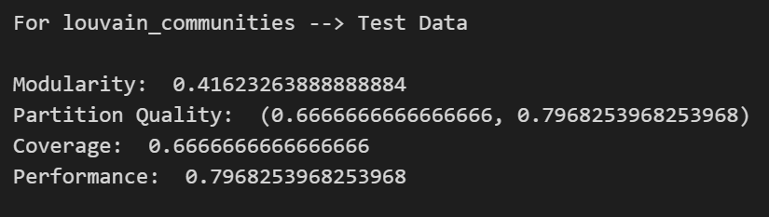
Best Model: louvain_communities
Notes:
Why Random Forest Regression is good?
A Random Forest Regression model is powerful and accurate. It usually performs great on many problems, including features with non-linear relationships
How is XGBoost different from random forest?
One of the most important differences between XG Boost and Random forest is that the XGBoost always gives more importance to functional space when reducing the cost of a model while Random Forest tries to give more preferences to hyperparameters to optimize the model..
n_estimators — the number of decision trees you will be running in the model

Slide 22


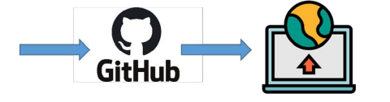

Model Deployment - Strategy
Web based deployment was used to deploy code from source control to hosting platform.
Streamlit and Streamlit-Cloud was used for web-framework app and deployment.
Heroku connects with GitHub to make it easy to deploy code living on GitHub to apps running on Streamlit.
Create a GitHub repository containing all the required files ( installation requirements, text files) etc.
Create an app on Heroku, and Streamlit - cloud to connect it to the GitHub repository.
Streamlit - Cloud & Heroku Deployment

Slide 23
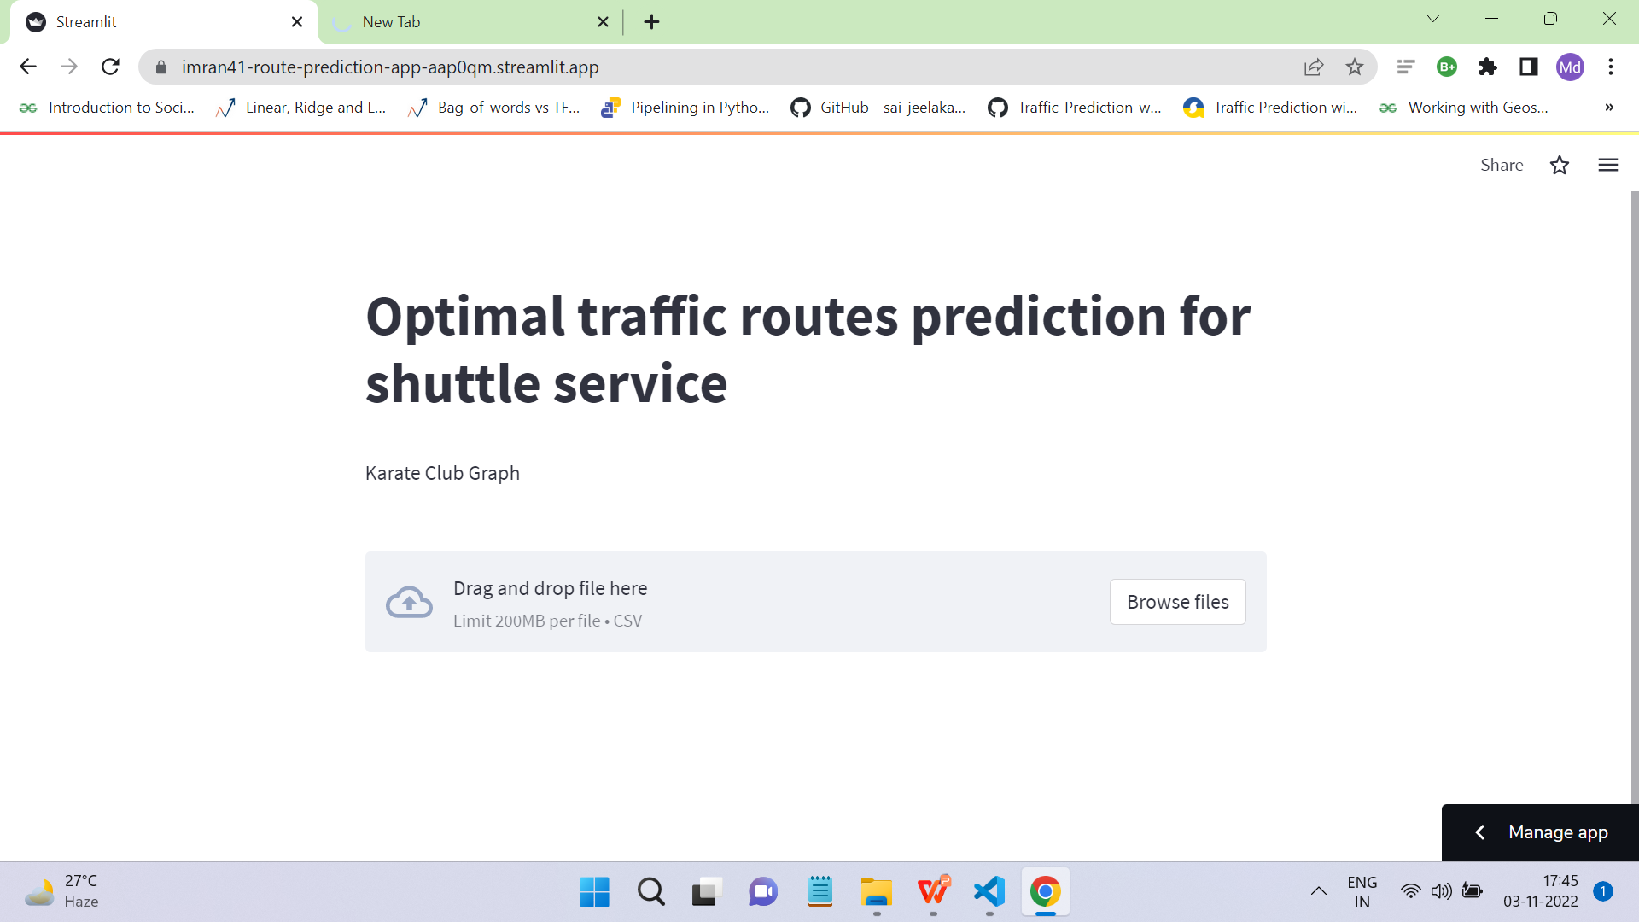
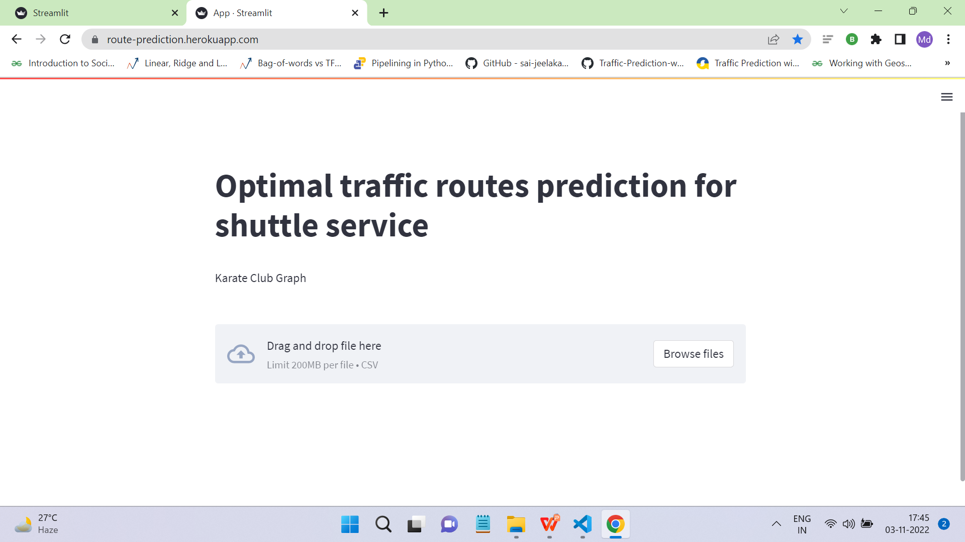
Screen shot of output - Streamlit-Cloud & Heroku

Slide 24
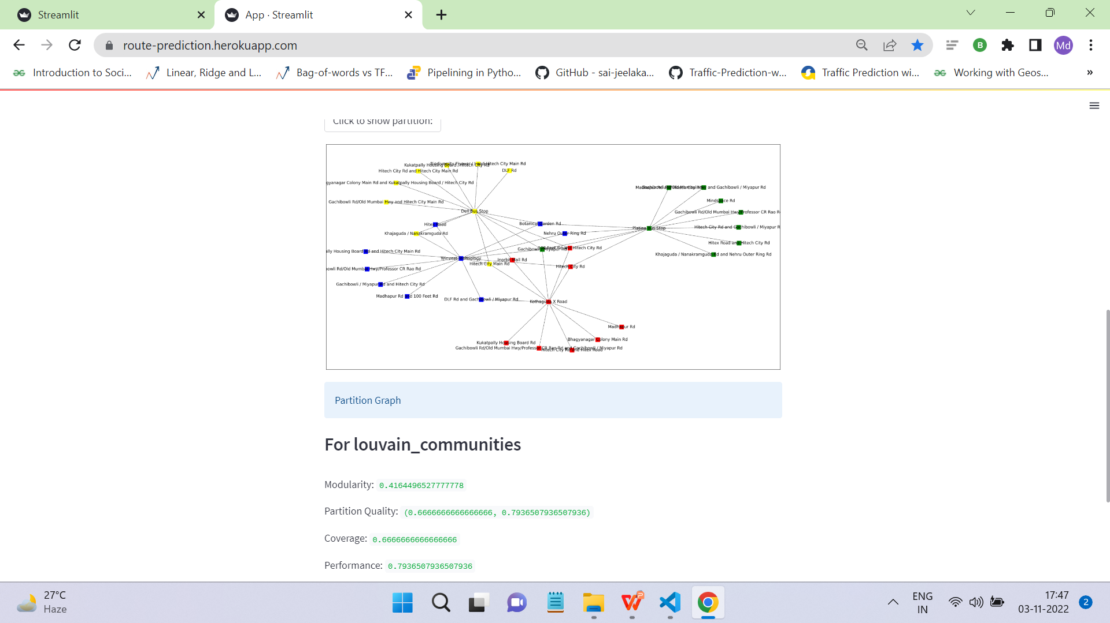
Screen shot of output

Slide 25
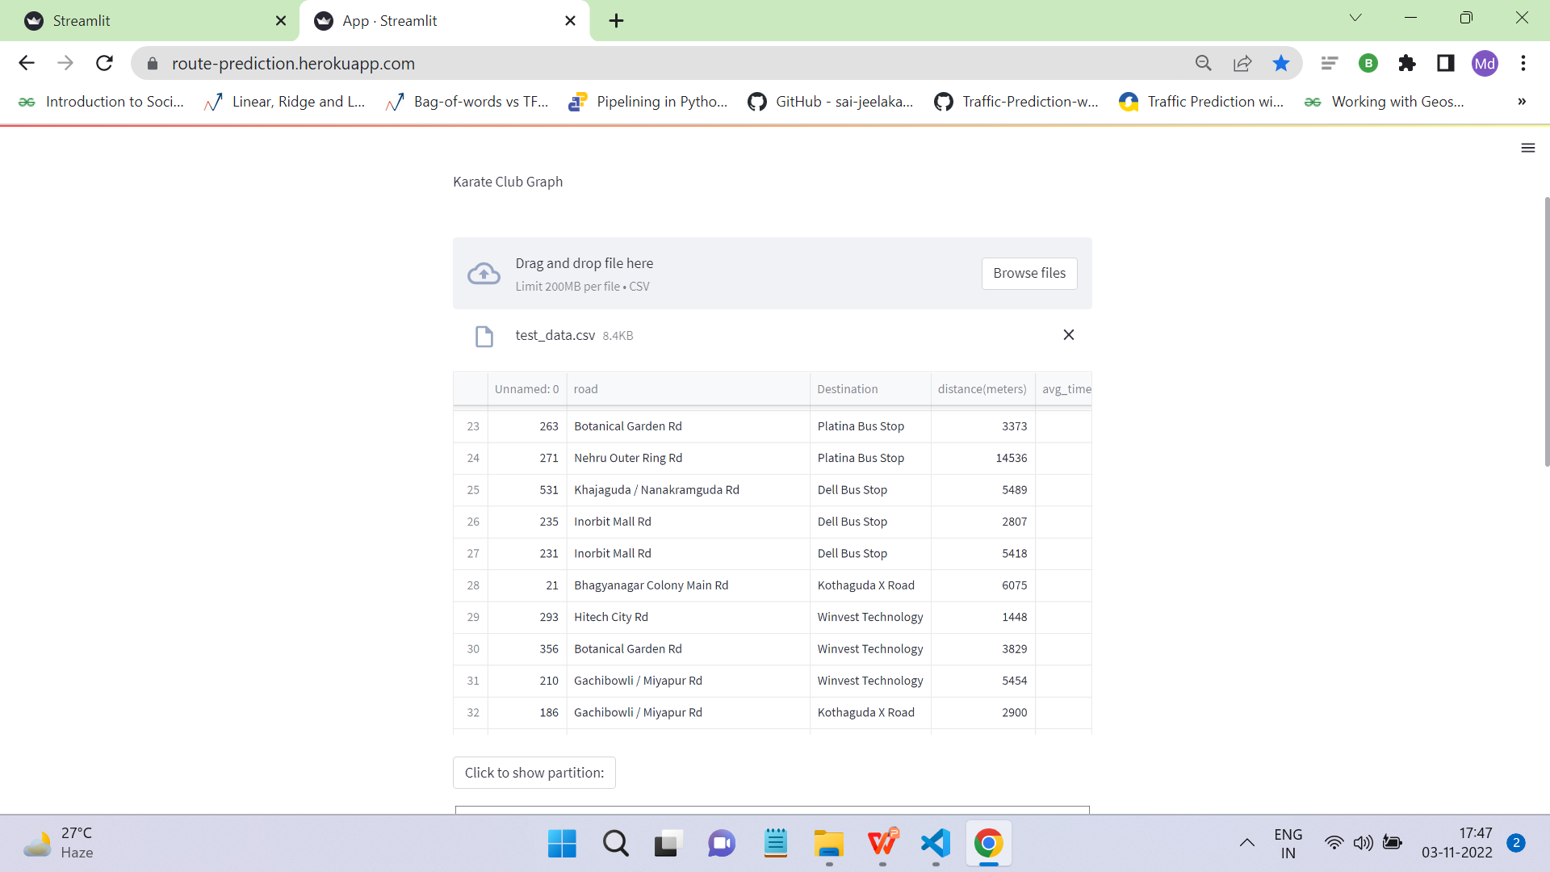
Screen shot of output

Slide 26
Video of output

Slide 27

Challenges
Some Reasons may got ignored during Model Building
No historical data is present for Route Prediction of Hyderabad
Very Few responses are taken to build ML model

Slide 28

Future Scope
Features updation according to the new trend.
Enhance Visualization and Improve Interactivity.
Measuring the success rate of the app.
Data collection through other online sources.
This model can be used for existing app’s also.
45

Slide 29

Queries ?

Slide 30


